Slide 1
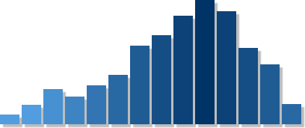
Facial Tissue Industry
Data Analysis, Interpretations and Visualizations
AlabbasCallisonKher Nath

Slide 2
Agenda
Summary
Market Review
Project Objective
Thought Process
Data Gathering
Visualizations & Insights
Sales Data
Pricing Data
Promotional Data
Location Data
Panel Data
Recommendations

Slide 3
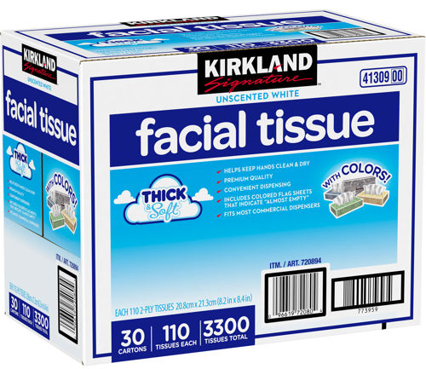
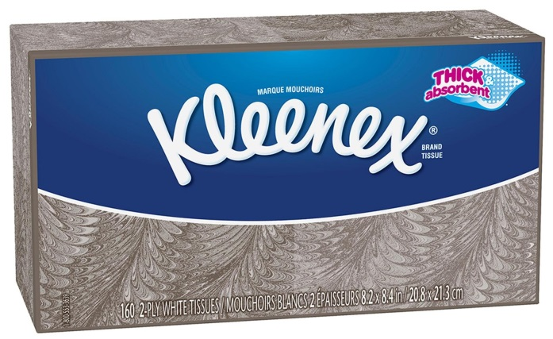
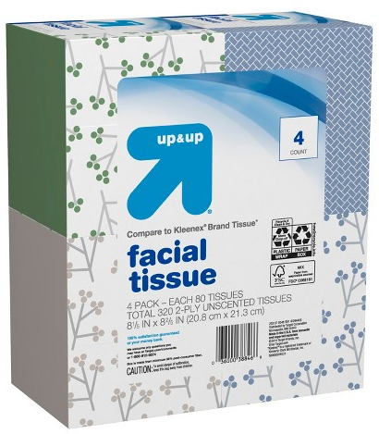

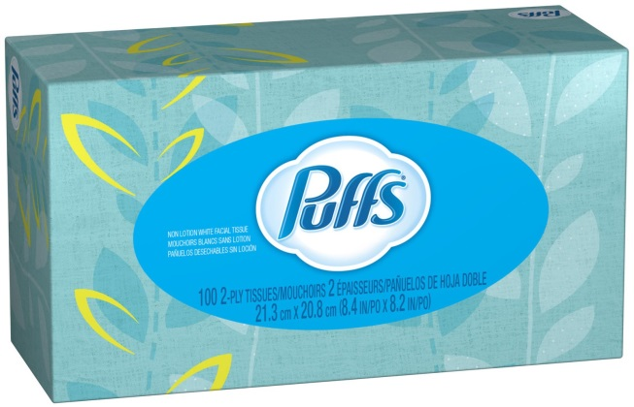
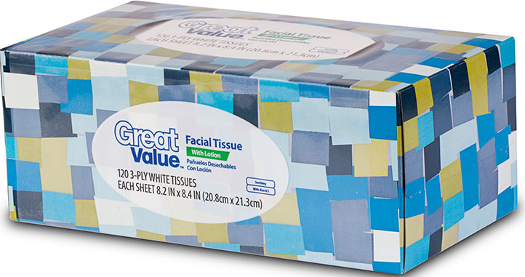
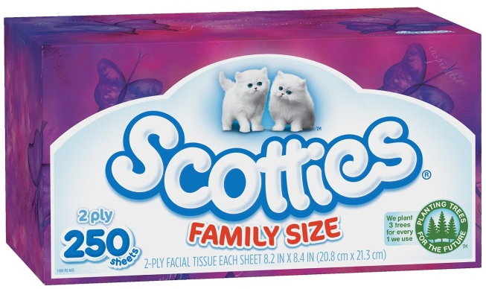

Slide 4
Summary
Datasets for the top 3 facial tissue brands are analyzed: Kleenex, Puffs, and Scotties
Datasets for private label tissue brands are analyzed: Walmart’s Great Value, Target’s Up & Up, and Costco’s Kirkland
Insights will show:
Sales trends
Sales per unit (pack)
Sales per volume (pounds)
Sales of grocery and drug stores
Brand and competitor price elasticity
Pricing per unit (pack)
Pricing per volume (pounds)
Pricing in grocery and drug stores
Feature promotions
Display promotions
Feature + Display promotions
Temporary price reductions
Customer panel data
Demographics
Location of sales quantities

Slide 5
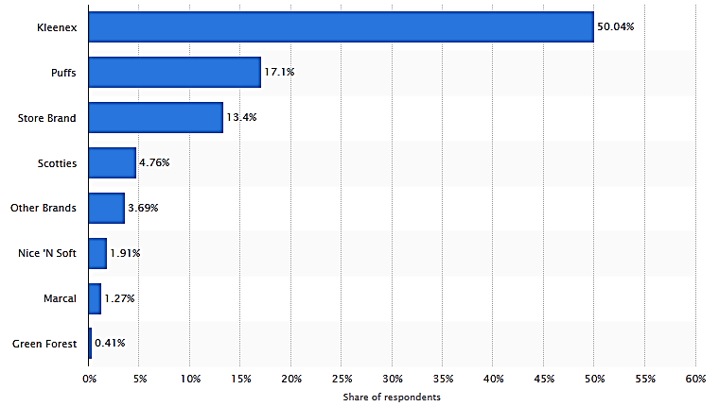






Market Research
Which brands of facial tissues do you use most often?
A was survey conducted from Feb 4, 2014 to Mar 11, 2015. 28,869 American adults were asked which brand of facial tissues is used by the people living in their household.

Slide 6
Project Objective
Based on the initial exploratory data analysis, we formed the following business questions:
What are the major drivers for facial tissue sales? Is there a seasonal pattern to sales?
To what extent does price drive facial tissue sales? What is the price elasticity? Are customers price elastic or inelastic? Does it differ by sales outlet?
To what extent do price discounts drive facial tissue sales?
What is the effectiveness of in-store promotions such as features and displays?
What is the competitive landscape of the facial tissues category? How do competitor price and promotions affect other brands?
What kinds of people are likely to buy a certain facial tissues brand?

Slide 7
Thought Process
Our goal is to analyze the facial tissues category and its major brands that will create a unified path to win at retail
Situation
Combine aspects of pricing, discounting, and in-store promotions across the US to generate a comprehensive strategy that will drive sales growth for the facial tissues category
Complication
How can we combine pricing and in-store promotion influences to help drive sales growth?
Question

Slide 8
Thought Process
We can derive a pricing and promotion strategy by combining aspects of pricing, discounting and in-store promotions
Elasticity modeling to estimate target and competitor price elasticities
Analyze in-store promotions like features, displays and temporary price reductions
Analyze sales performance in different stores
Target price elasticity to estimate effects of target price changes
Cross price elasticity to estimate effects of competitor price changes
Feature promotion analysis
Display promotion analysis
Estimate effects in Grocery stores
Estimate effects in Drug stores

Slide 9
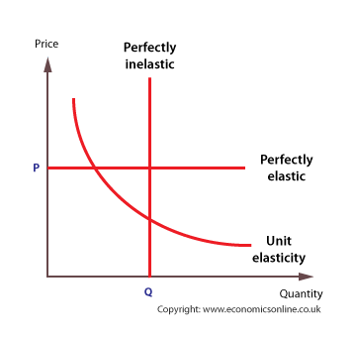
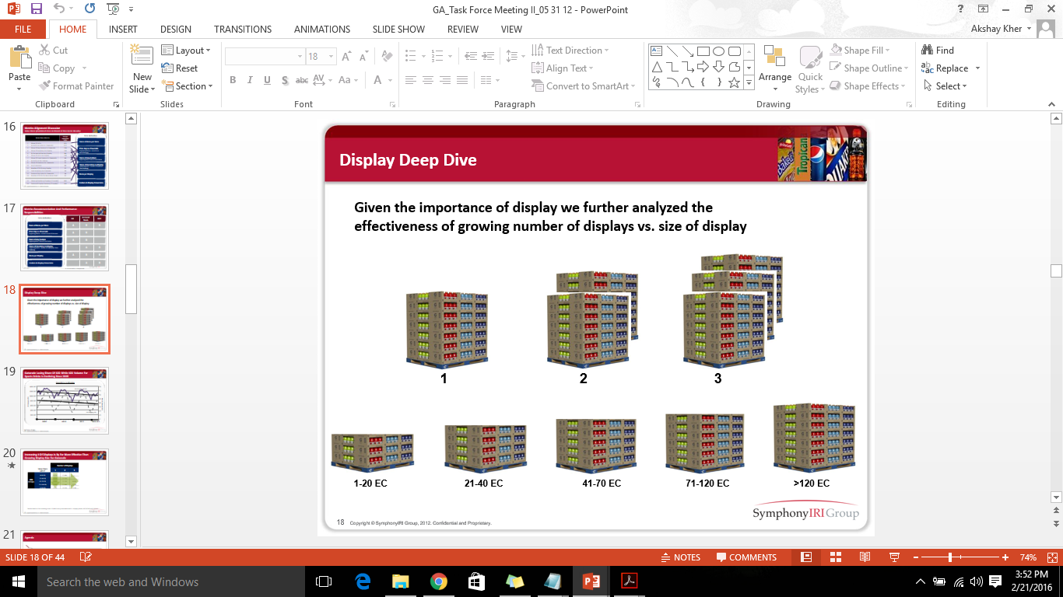
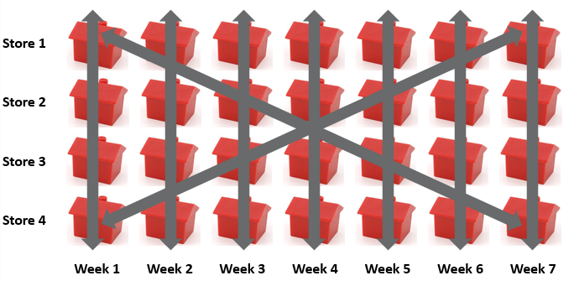
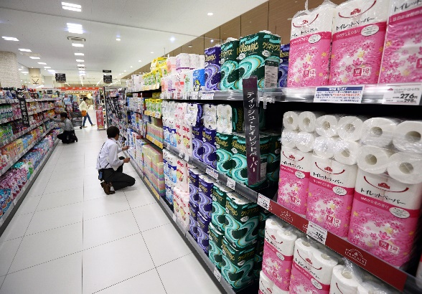
Thought Process - Storyboard
Estimating target and cross price elasticities
Analyze in-store promotions
Analyze sales performance in different stores
Estimating effects in drug vs grocery stores

Slide 10
Data Gathering
Data source: IRI (Information Resources Inc.), a company that collects point of sale data of sample stores across the US
Category: Facial Tissues
Time Period: 2 years (2004-2005)
Sample: ~ 2,000 stores across the US
Geography: Total US Grocery, Total US Drug
Panel Data: ~ 7,500 panelists across Wisconsin and Massachusetts
Data synthesis and analysis done in SAS

Slide 11
Visualizations and Insights
Sales

Slide 12
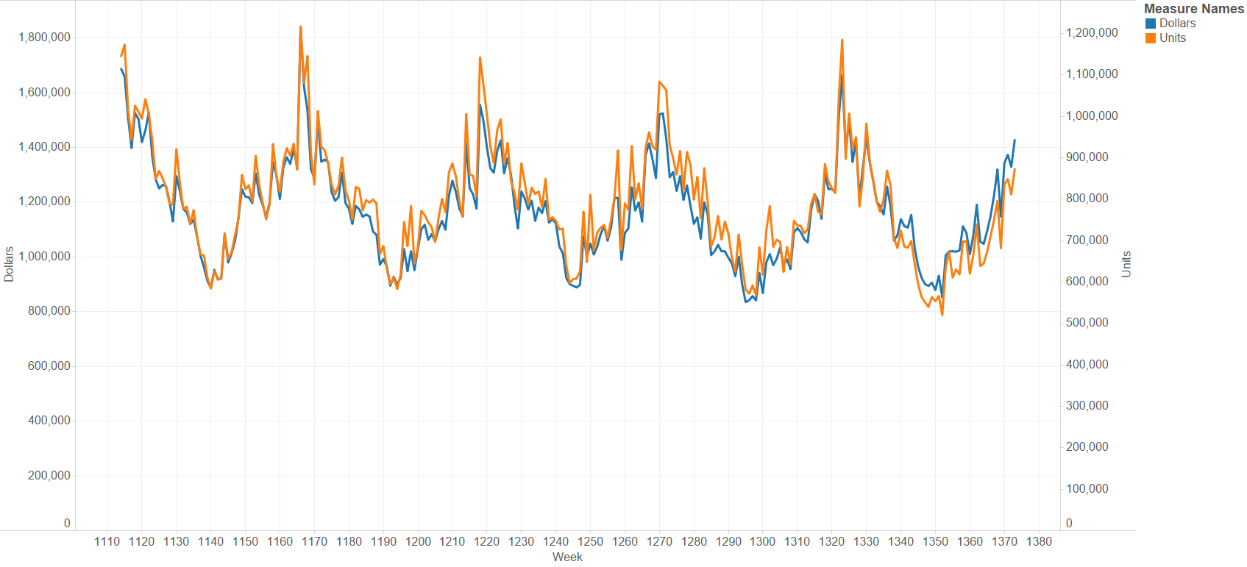
Sales for Facial Tissues have remained constant over the past 5 years
Dollar and units trend over 5 years show sales peaking during the end of the year. This shows a clear seasonal patter which needs to be incorporated in any analysis aimed at estimating individual pricing and promotion effects.

Slide 13
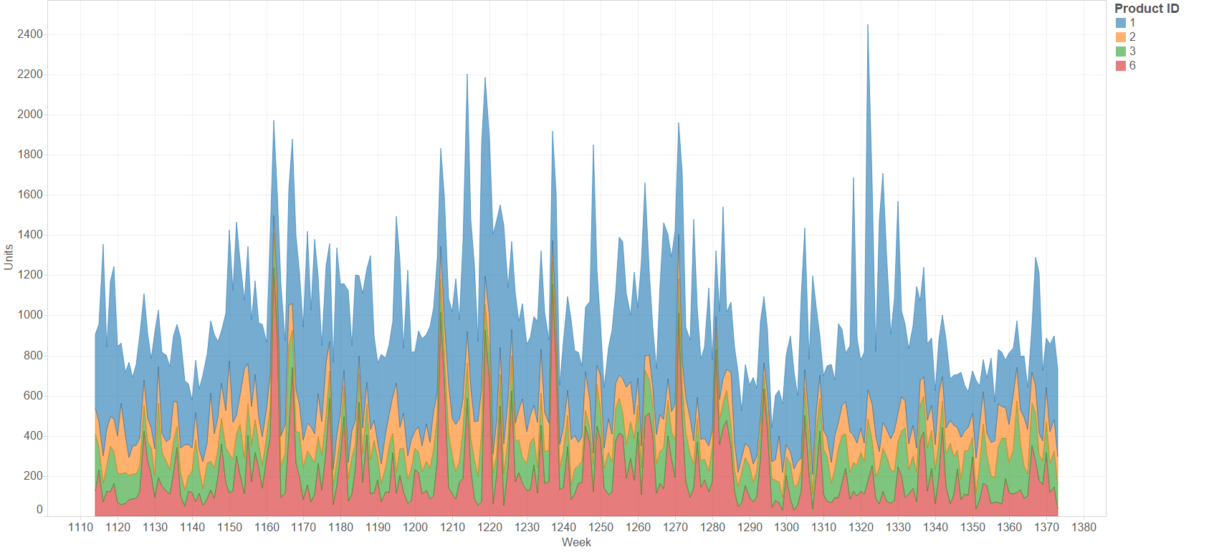
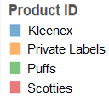
Kleenex is the top performing brand followed by the Private Labels and Puffs
Sales units trend over 5 years by brand

Slide 14
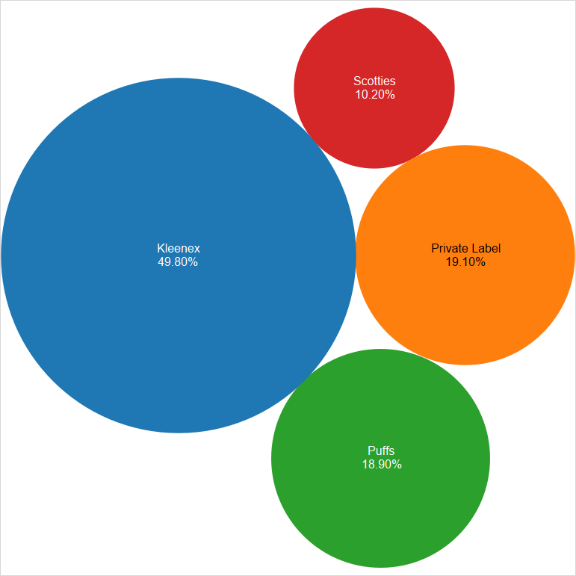
Kleenex is the top performing brand followed by the Private Labels and Puffs
Total market share by brand

Slide 15
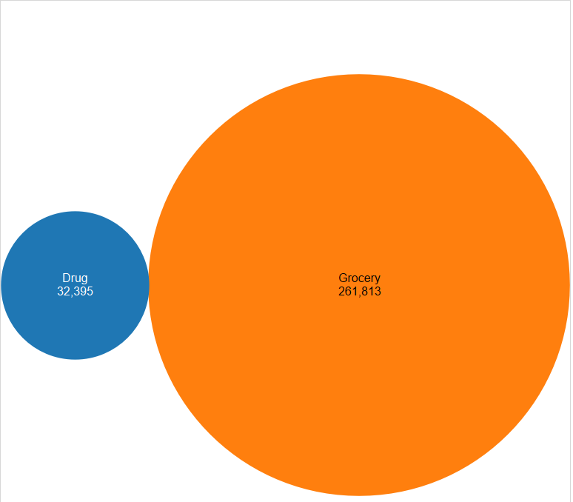

Around 95% of total sales come from grocery stores
Total units sold by outlet

Slide 16
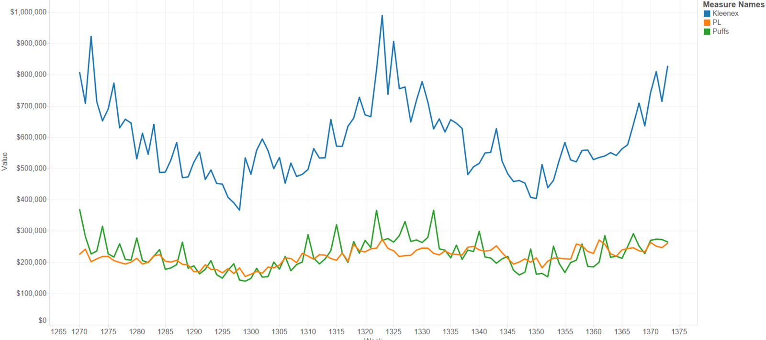
Kleenex is the leader in the Facial Tissues category with 50% market share
 | 2003 | 2004 | 2005
Kleenex | 49.9% | 49.0% | 49.8%
Puffs | 17.8% | 18.4% | 19.1%
Private Level | 16.6% | 17.3% | 18.9%
Dollar share of the top 3 brands

Slide 17
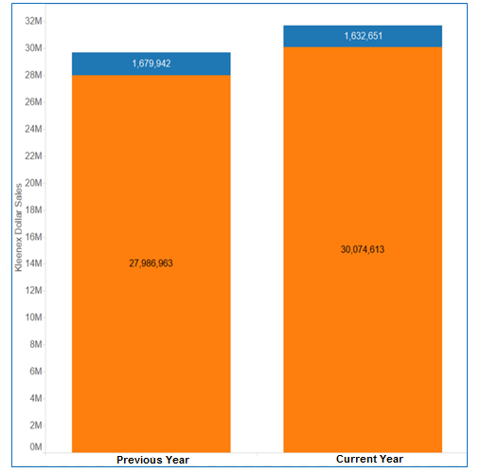
About 95% of Kleenex Dollar Sales are from the Grocery Outlet
Percent of Kleenex Dollar Sales - by Outlet
 | 2014 | 2015
Total U.S. Grocery | 94% | 95%
Total U.S. Drug | 6% | 5%
Total dollar sales by outlet

Slide 18
Visualizations and Insights
Pricing

Slide 19
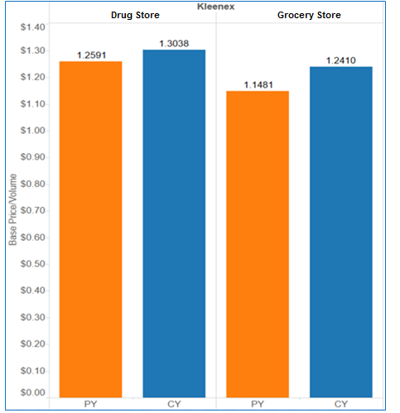

Kleenex Base Price Per Volume increased marginally both in Grocery and Drug
Kleenex - Average Base Price Per Volume

Slide 20
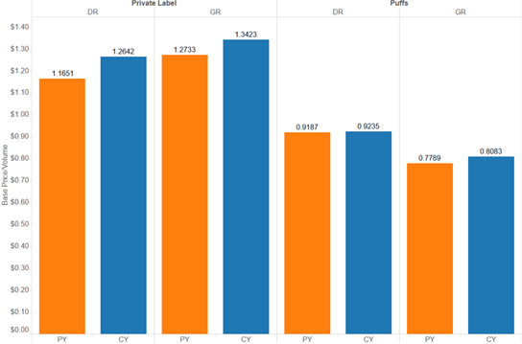
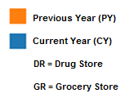
Average Base Price Per Volume increased marginally for Puffs and Private Label
Private Label and Puffs - Average Base Price Per Volume

Slide 21
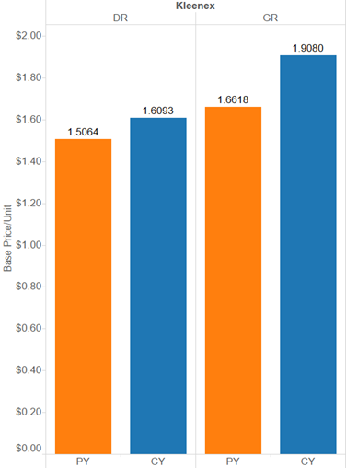
Kleenex Average Base Price Per Unit increased marginally both in Grocery and Drug
Kleenex - Average Base Price Per Unit

Slide 22
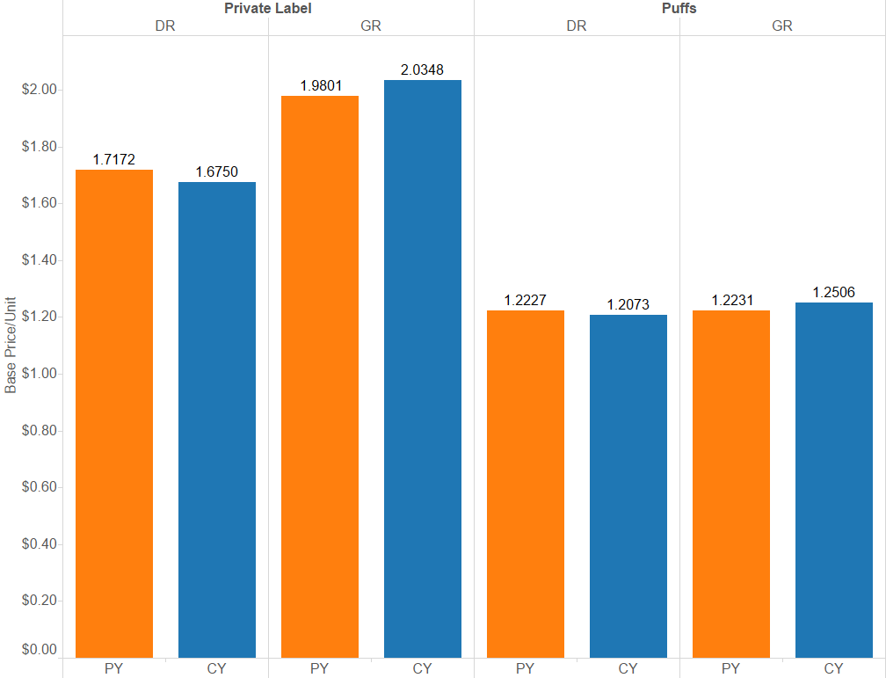
The Average Base Price Per Unit for Private Label decreased marginally in Drug but increased in Grocery
Private Label and Puffs - Average Base Price Per Unit

Slide 23
Everyday Price Elasticities – CPG Rules Of Thumb
Magnitude of Elasticity Coefficient | Rule of Thumb
< -1.71 | Highly Elastic
-1.21 to -1.70 | Elastic
-1.00 to -1.20 | Moderately Elastic
-0.51 to -0.99 | Inelastic
> -0.50 | Highly Inelastic
Sensitivity to Change in Everyday Price
Price elasticity quantifies the impact of price change, and can be leveraged to manage pricing and profit risk associated with price changes.

Slide 24
Price Sensitivity: Putting Facial Tissues Price Response Into Perspective
Kleenex
Grocery
-1.65
Puffs
Grocery
-1.46
Highly Elastic
-1.7
-1.2
-1.0
-0.5
Highly Inelastic
Elastic
Moderately Elastic
Inelastic
Price Elastic/Sensitive
Price Inelastic/Insensitive
Imported
Beer
-2.2
Premium
Ice Cream Bars
-1.30
Chocolate/Candy/Gum
-1.39
Specialty
Sports
Drink
-1.18
Premium Chocolate
-1.20
Gum
-1.10
Premium Skin Care
-0.75
Adult
Tooth Brushes
-0.61
Breath Mints
-0.50
Super Premium Alcohol
-0.40
Men’s Fragrances
-0.3

Slide 25
Responsiveness to Base & Promo Price Changes Can Be Leveraged to Set Pricing Strategy for the Portfolio
Promo Price Elasticity
Promoted Depth
Price Protect
Less Responsive
to Promo Price
High Base/Low Promo Responsiveness
Worst Position During Periods of COGS Inflation
Drive Volume Growth Through EDLP During Periods of COGS Relief
Low Base/Low Promo Responsiveness
Cover COGS Inflation With Base Price Increases
Limited Opportunity to Protect Volume Due to Poor Promo Response
Base Price Elasticity
Quality Frequency
Drive Margin
More Responsive
to Promo Price
High Base/High Promo Responsiveness
Protect Against COGS Inflation Driven Base Volume Losses Through Incremental Promo
Good Position During Periods of COGS Relief
Low Base/High Promo Responsiveness
Cover COGS Inflation With Base Price Increases
Protect Volume Through Incremental Promotion
Don’t Reduce Base Price to Drive Volume
More Responsive to Base Price
Less Responsive to Base Price

Slide 26
Facial Tissue Price Responsiveness 2015 Elasticity Quadrant Analysis
2015 Kleenex Price Responsiveness Landscape
Promoted Depth
Price Protect
Smaller Promo
Price Impact
Kleenex Base Price Elasticity : -1.65
Kleenex Promo Price Elasticity : -1.85
Larger Promo Price Impact
Quality Frequency
Drive Margin
More Responsive to Base Price
Less Responsive to Base Price

Slide 27
Consider All Factors When Looking At Price Management
Checklist for price management:
Questions regarding price management:
Own Price Elasticity
Competitor Cross Elasticity
Price Thresholds
Competitive Price Gaps
Price Distribution
How does my elasticity compare to the category average? Relevant competitors? Within my portfolio?
What competitive products do we interact with for price? What is the strength of that Interaction? How much price risk is mitigated if competition follows my pricing action?
Are there price point thresholds at which my consumer response to price accelerates?
Are there price gap thresholds at which my consumer response to price accelerates?
What marketplace ACV is at risk of crossing price point or gap thresholds with a pricing action?

Slide 28
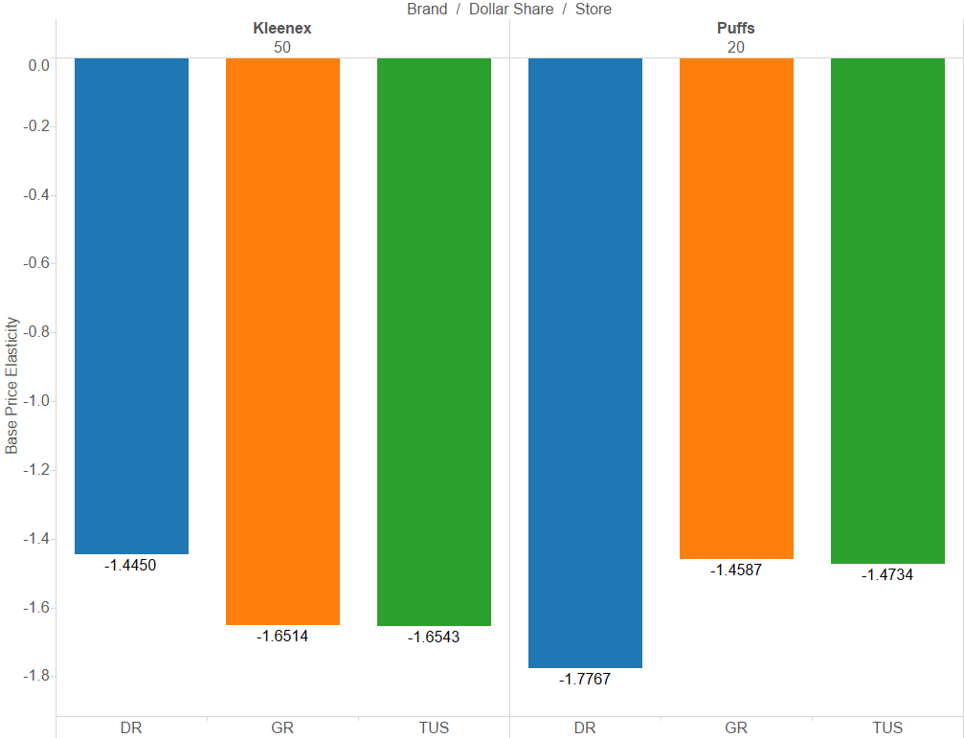
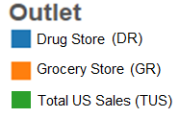
Opportunities exist for pricing within grocery and drug for portfolio optimization
Puffs should consider a price cut in Drug stores as consumers are sensitive to price changes.
In grocery stores, Kleenex can decrease prices to generate additional revenue.
Base Price Elasticity for Kleenex and Puffs (Grocery, Drug, & Total US sales)

Slide 29
Price Increase simulation with competitor effects
Base Price Elasticity With Competitive Cross Effects – Kleenex, Total U.S. Grocery
Volume Change With Competitive Price Increases*
Kleenex Increases Price 10%
Kleenex (10%) & PL (10%) Increase
Kleenex (10%) and Puffs (10%)Increase
Kleenex (10%)& Scotties (10%) Increase
Kleenex & All Competitors Increase Price*
-1.65
Kleenex Base Price Elasticity
Private Label
Puffs
Scotties
Marcal
Caspari
Other
Nice N Soft
Pro Tissues
Kleenex Net Price Elasticity
-0.74
Puffs and Scotties have larger price interactions compared to Private Label

Slide 30
Visualizations and Insights
Promotional

Slide 31
Feature Promotion for Facial Tissues has increased steadily over the past five years
Facial Tissues Feature Promotion

Slide 32
Display Promotion for Facial Tissues has also increased steadily over the past five years
Facial Tissues Display Promotion

Slide 33
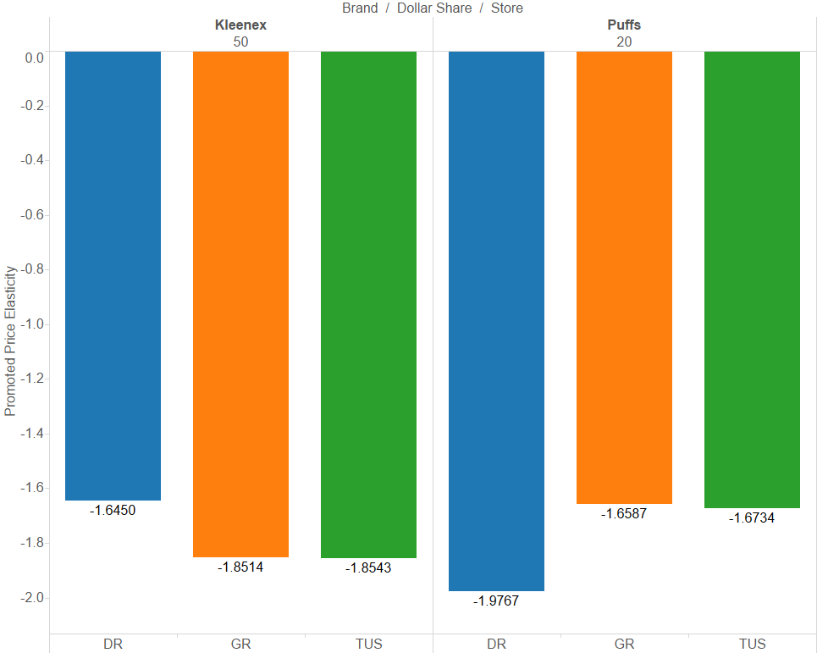
Opportunity exists for Puffs and Kleenex to play a larger role in merchandising due to higher discounting responsiveness
Kleenex is highly responsive to promotion in grocery stores.
Puffs is highly responsive to promotion in drug stores.
Consider deeper price discounts to provide larger volume increases.
Promotional Price Elasticity for Kleenex and Puffs (Grocery, Drug, & Total US sales)

Slide 34
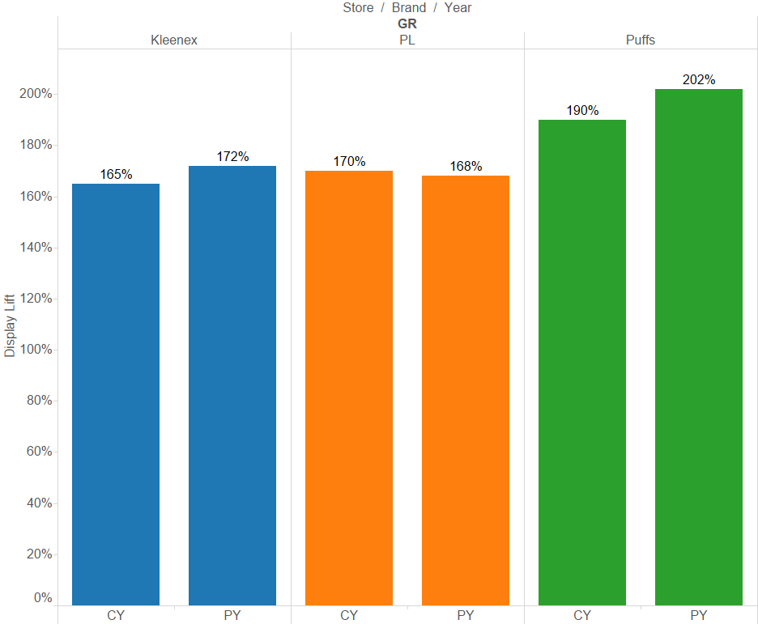

Puffs displays outperform Kleenex and Private Label in Grocery
Puffs displays have gained effectiveness compared to the previous year.
2-Year Grocery Store Display Lift for Kleenex, Private Labels (PL) and Puffs

Slide 35
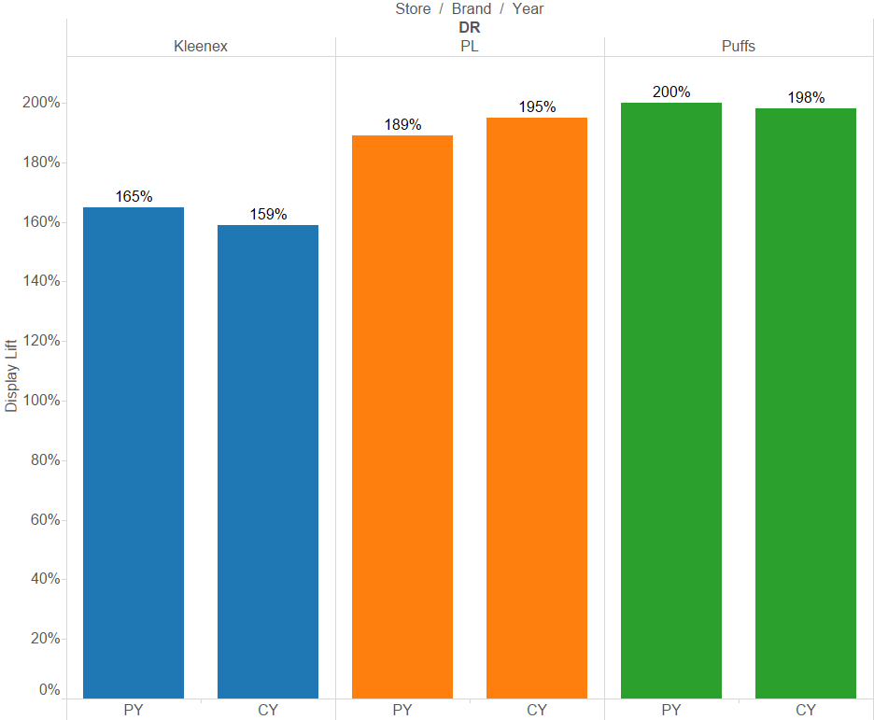
Puffs displays outperform Kleenex and Private Label (marginally) in Drug
Kleenex and Puffs displays have lost effectiveness compared to the previous year.
2-Year Drug Store Display Lift for Kleenex, Private Labels (PL) and Puffs

Slide 36
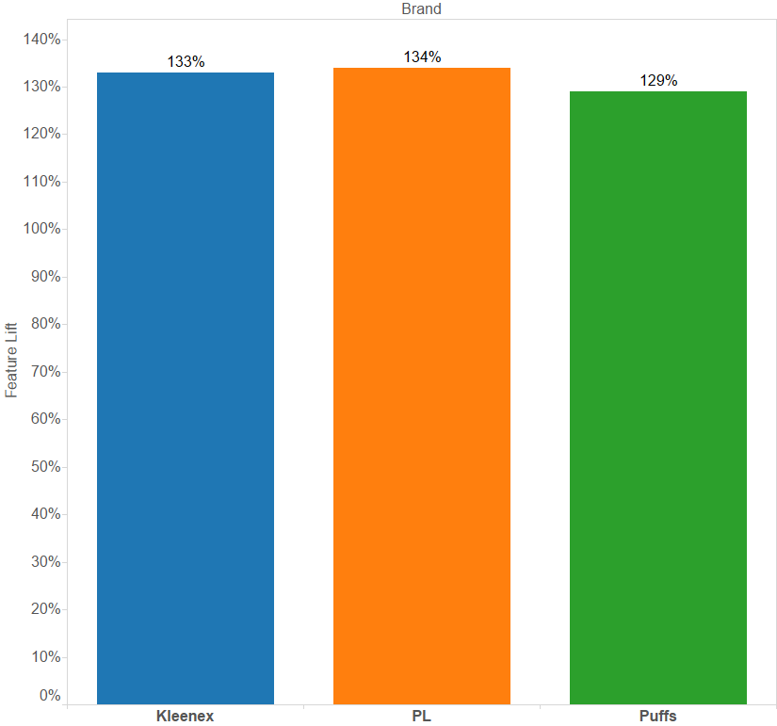
Private Label displays outperform Kleenex and Puffs
Total US Sales - Feature Lift for Kleenex, Private Labels (PL) and Puffs

Slide 37
Visualizations and Insights
Location

Slide 38
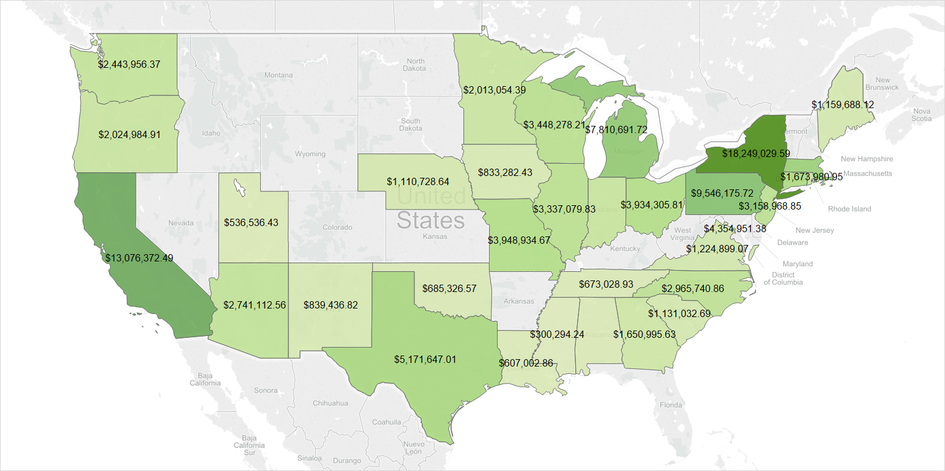
California and New York are the highest consumers
Total facial tissue sales per state – map view

Slide 39
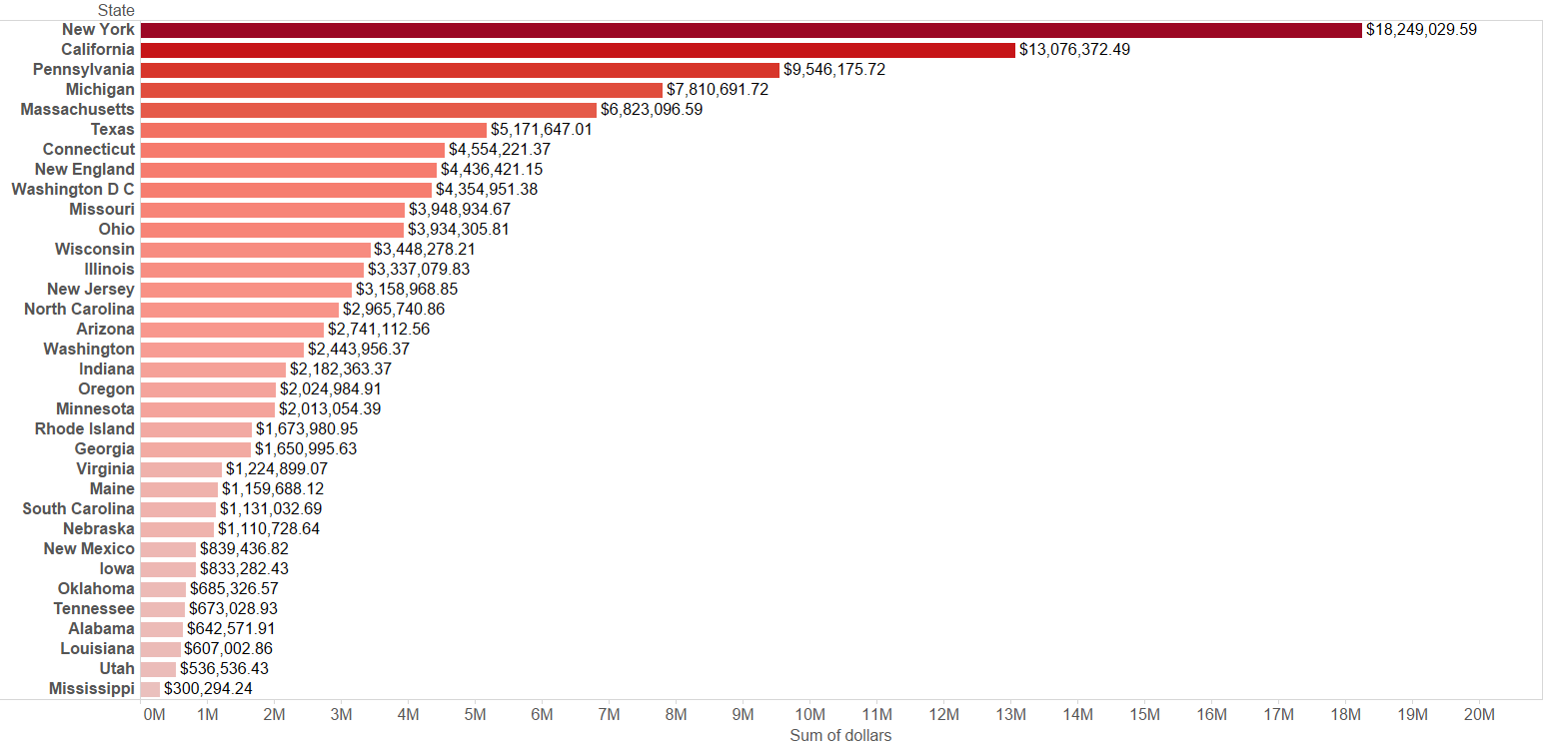
California and New York are the highest consumers
Total facial tissue sales per state – bar view

Slide 40
Visualizations and Insights
Panel

Slide 41
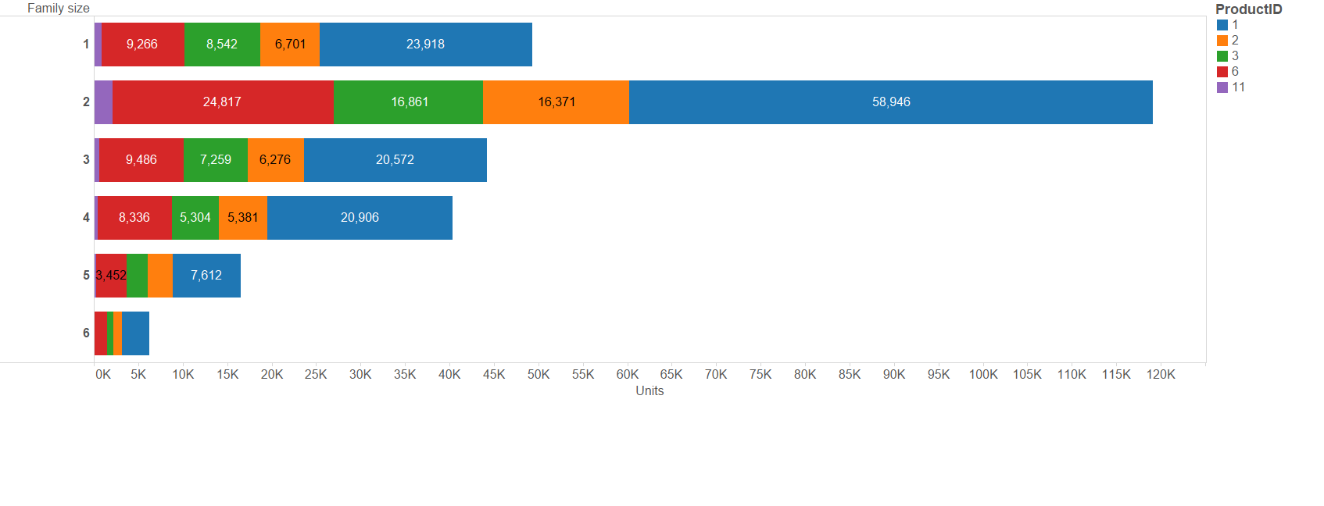
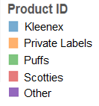
Family size of two generates maximum value for Facial Tissues
Unit Sales by Brand and Family
‘1 = 1 person in household’, ‘2 = 2 people in household’, ‘3 = 3 people in household’, ‘4 = 4 people in household’, ‘5 = 5 people in household’, ‘6 = 6 people in household’

Slide 42
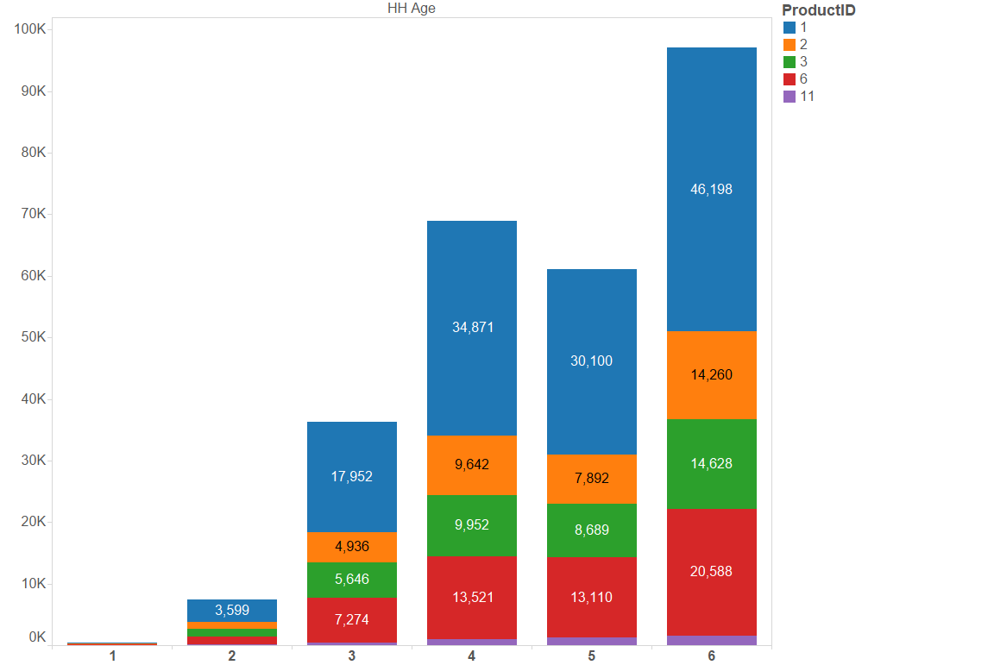
Age group of 65+ years generates maximum value for Facial Tissues
Unit Sales by Age Group
‘1 = 18-24’, ‘2 = 25-34’, ‘3 = 35-44’, ‘4 = 45-54’, ‘5 = 55-64’ and ‘6 = 65+’

Slide 43
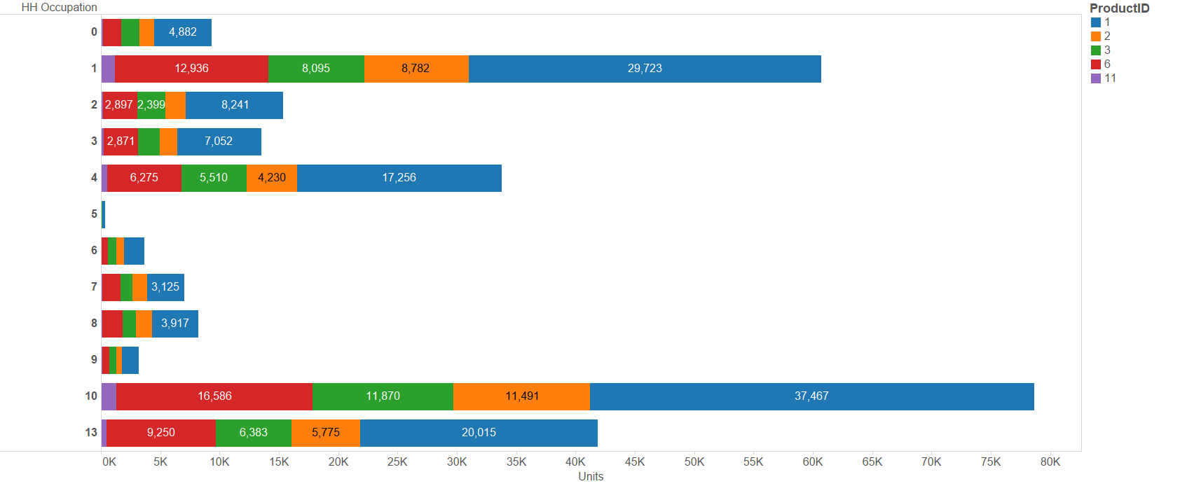
Retired people generate maximum value for Facial Tissues
Unit Sales by Profession
‘1 = ‘Professional or Technical’, ‘2 = Manager’, ‘3 = Sales’, ‘4 = Clerical’, ‘5 = Craftsman’, ‘6 = Operative’, ‘7 = Laborer’, ‘8 = Cleaning’, ‘9 = Private HH Worker’, ‘10 = Retired’

Slide 44
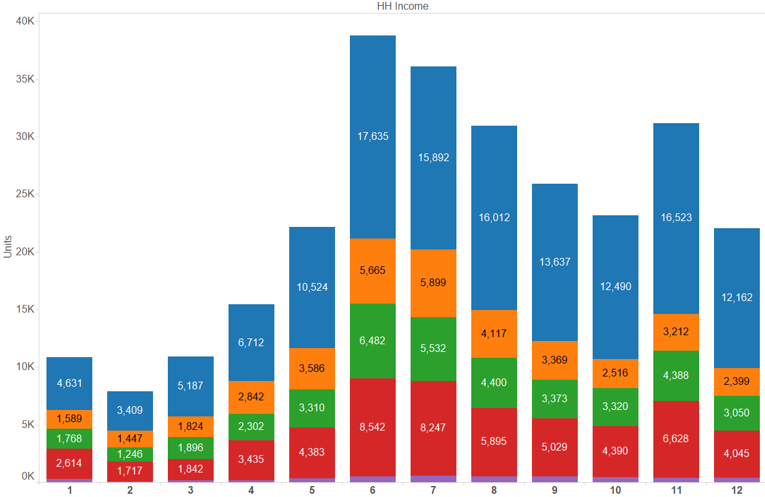
Panelists earning between $25,000 - $30,000 generate maximum value for Facial Tissues
Units sold by household income

Slide 45
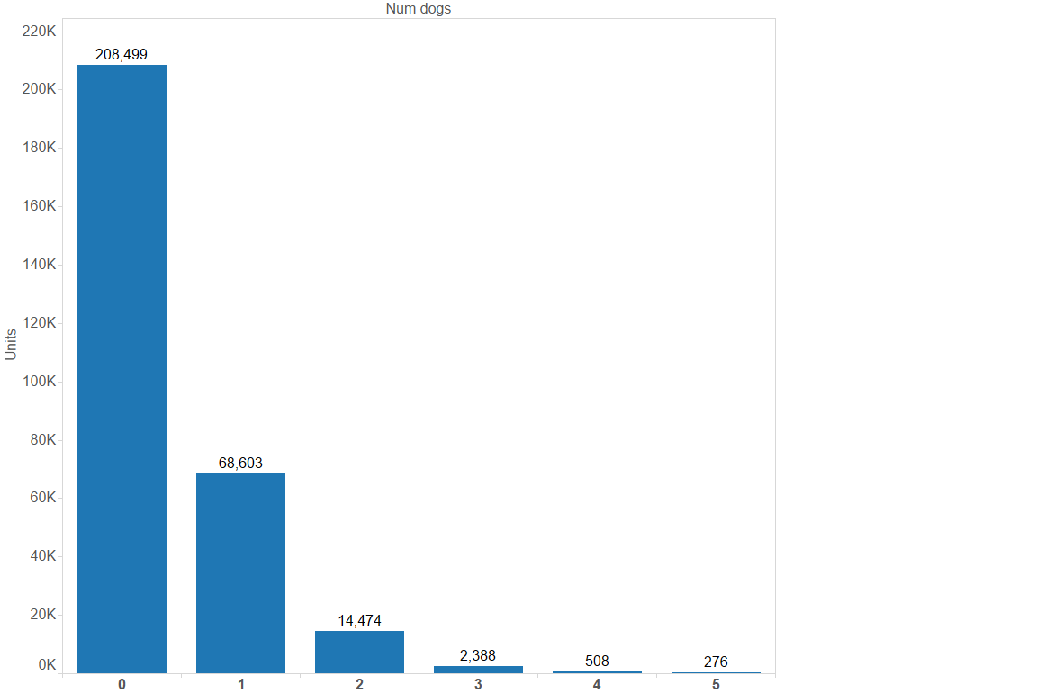
People without pets generate maximum value for Facial Tissues
Unit sales (all brands) by number of dogs in a household
‘0= No dogs’,’1=One dog’,’2= Two dogs’, ’3= Three dogs, ’4= Four dogs, ’5= Five dogs, ’6= Six dogs

Slide 46
Recommendations - Panel
Family size of two generates maximum value for facial tissues.
Age group of 65+ and retired people are likely to be high buyers.
People having income between $ 25,000 - $ 30,000 generate maximum value.

Slide 47
Recommendations - Kleenex
To revive Kleenex’s growth trajectory, the brand must manage price and promotion optimally.
Developing a pricing structure and promotional guidelines from fact-based analytics sets compliance expectations from field sales & retailers alike
Although Kleenex is the market leader, its growth seems to have saturated since the last 4 – 5 years.
Display effectiveness has also decreased year over year.
Consider decreasing prices to take advantage of elastic demand to drive revenue.
Display effectiveness decreases year over year. Use price discounts instead of displays to drive volume, particularly in grocery stores.
Do not ignore competition from Private Labels and Puffs.

Slide 48
Recommendations - Puffs
Dollar share is steadily increasing, but the company needs to manage price and promotion optimally to gain additional market share.
Consider decreasing prices to take advantage of elastic demand to drive revenue.
Continue to use price discounts to drive volume, particularly in drug stores.
Display effectiveness is highest among competitors. Optimize this by including more display promotions instead of feature promotions.

Slide 49
Recommendations – Private Labels
Dollar share is steadily increasing, but companies need to manage price and promotion optimally to gain additional market share
Focus on price discounts and display promotion to drive additional revenue

